Slide 1
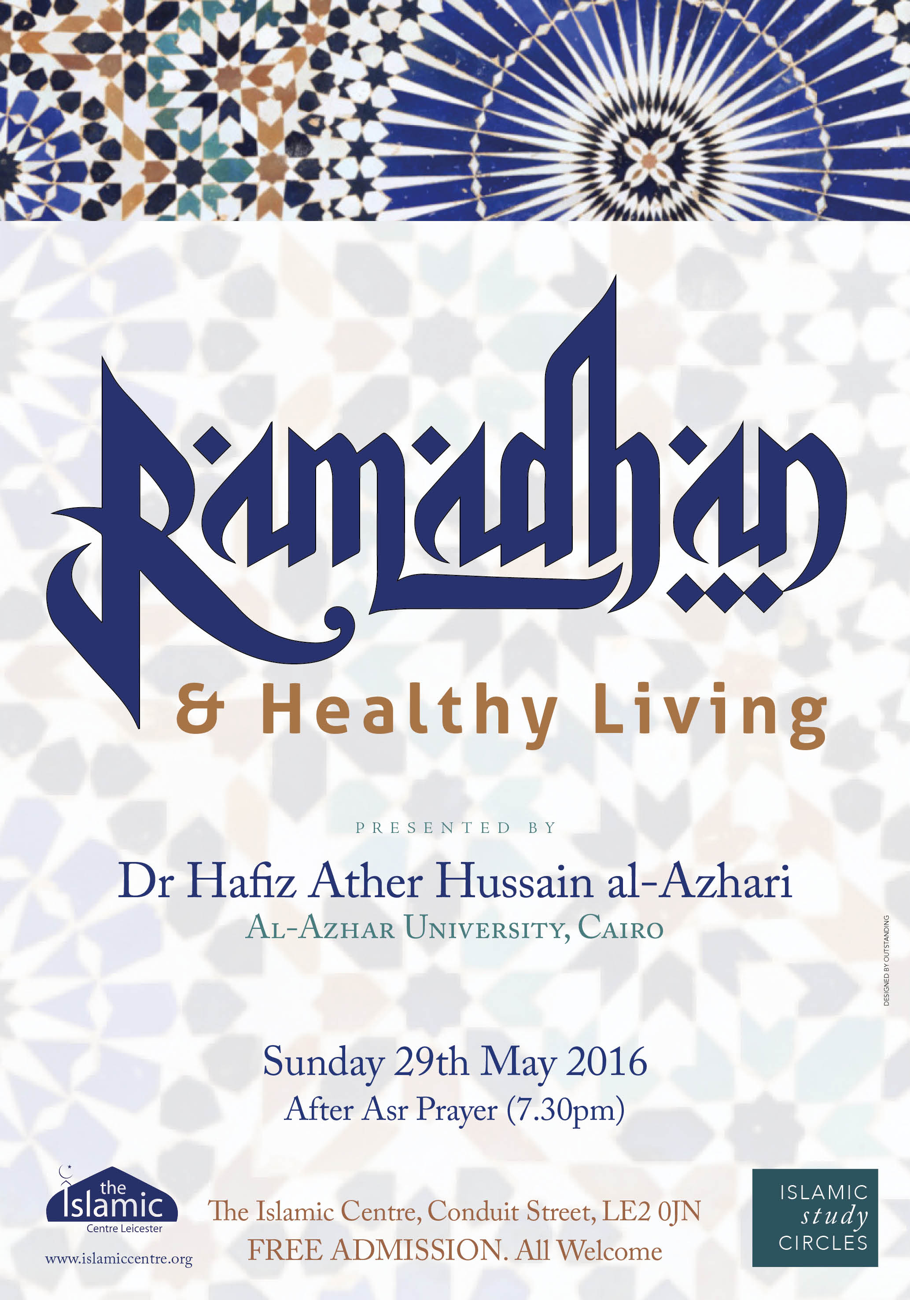
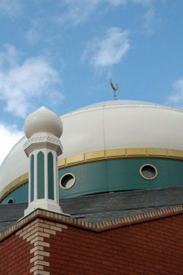
Dr. Hafiz Ather Hussain al-Azhari

Slide 2
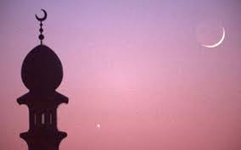
Format of the programme
Hunger and Islam
What happens to the body when we fast?
The health benefits of fasting
Potential health complications
Diabetes
What should we consume & what should we avoid
Q&A

Slide 3
Introduction
Early Muslims did not merely take religion from Allah & His Messenger ﷺ, they took everything, including health tips.
The primary purpose of Ramadan is taqwa, yet there are so many health benefits to be gained from fasting and observing Ramadan correctly.

Slide 4
The benefits of hunger
Hunger cannot be a bad thing, not least because Prophet Muhammad ﷺ chose a life of hunger.
Hunger teaches discipline: if one can control his food intake, he can control anything.
Imam al-Qushayri said, ‘For me to raise my hands from my plate while I am hungry is better than the whole night in prayer.’
When a person is hungry and thirsty, ironically he appreciates Allah’s favours more not less. He thoroughly enjoys the first sip of water at Iftar.

Slide 5
What happens to the body during a fast?
STAGE ONE
Technically, the body enters into the fast state eight hours after Sehri. This is when the gut finishes the job of absorbing the nutrients from the food consumed.

Slide 6
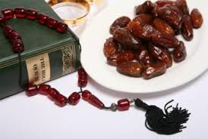
What happens to the body during a fast?
STAGE TWO
Body glucose (which is stored in the liver and muscles) then becomes the major source of energy for the body. .

Slide 7
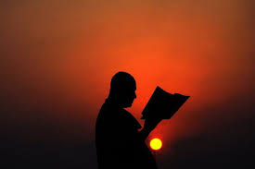
What happens to the body during a fast?
STAGE THREE
Once this finishes, fat becomes the next store of energy. It is at this point that fasting can lead to healthy weight loss. Using fat as energy also preserves the muscles and reduces the cholesterol level.

Slide 8
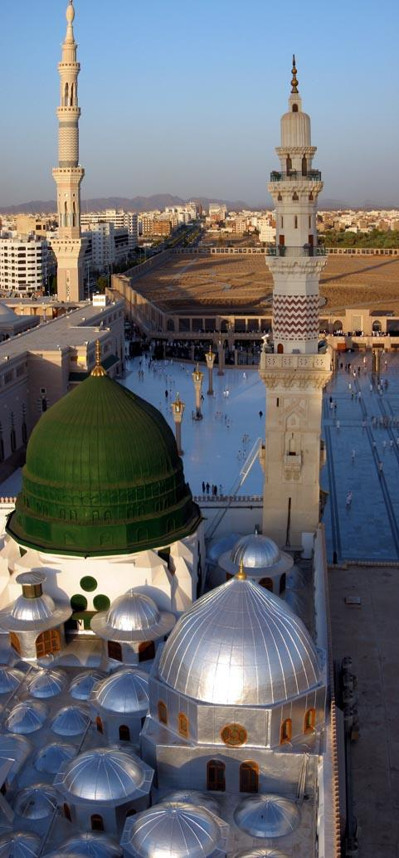
Prolonged fasting (Sawm Wisal)
In the case of prolonged & continuous fasting, the body will start using protein as a source of energy. This is known as starvation and it is obviously unhealthy. Because Ramadan is not for continuous days, there is no chance of this happening.
Continuous fasting is forbidden in Islam. However, it was permissible for Prophet Muhammad ﷺ, who did practice it.

Slide 9
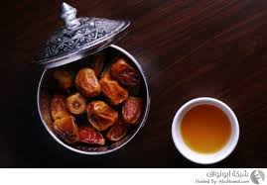
What does regular fasting do to the body?
In short, fasting brings multiple health benefits…

Slide 10
Calorie reduction leads to:
Reduced risk of cancer
Reduced risk of heart diseases
Reduced risk of obesity
Improvement to our immune system
Slowing down of the ageing process

Slide 11
Other benefits of fasting:
Reduced bad cholesterol
Lower blood pressure
Though the research is still ongoing, there are suggestions that regular fasting can delay the onset of Alzheimer’s disease

Slide 12
How does fasting help so much?

Slide 13
Help via healing…
When we fast – by resting our digestive system– we are saving on this 20% energy and we are then using it to heal and recuperate our body. This freed up energy is then directed towards detox, repair of cells, tissues & organs. This is what leads to better health overall and good quality of life.

Slide 14
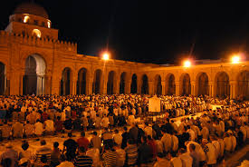
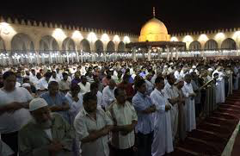
Salah al-Tarawih
After Iftar, the blood glucose level continues to rise from the food taken in. Just before the Iftar, the blood glucose and insulin levels are at their lowest level. So Tarawih is instrumental (because of the light body movement) in ensuring balance once again.

Slide 15
Possible health complications
Migraines
Heartburn
Dehydration

Slide 16
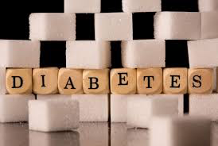
Diabetes
Insulin: this is a hormone produced by the pancreas that allows glucose to enter the body’s cell, so that it can be used for fuel for energy.
Glucose: This comes from digesting carbohydrates and it’s also produced by the liver.
Diabetes is a condition where the amount of glucose in the blood gets too high. This happens when (i) the pancreas doesn’t make any insulin (ii) the pancreas doesn’t make enough insulin to help the glucose enter the body’s cell.

Slide 17
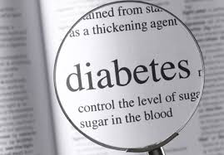
How does fasting affect diabetics?
After eight hours of fast, the body starts to use energy stores to keep our blood glucose (sugar) levels normal. For most people, this is not a problem. For those suffering with diabetes, they are at risk of low blood glucose levels, which is called hypoglycaemia. Sometimes, after a larger meal (Sehri or Iftar), there is a risk of high blood glucose levels.
Diabetics must seek medical advice before Ramadan!

Slide 18
Good Ramadan food
Fruit and vegetables
Brown bread
Dates
Cereals
Barley, wheat & oats
Figs
Lentils
Nuts
Milk, yoghurt & cheese

Slide 19
Food to avoid
Fried & fatty foods
Food with excessive sugar like mithai
High-fat cooked foods like parathas
Soft drinks

Slide 20
Cooking methods
Shallow frying
Grilling
Baking
Deep frying
Excessive use of oil

Slide 21
Conclusion
Ramadan is about spirituality. But it is amazing how spirituality leads to improved physicality too.

