Slide 1
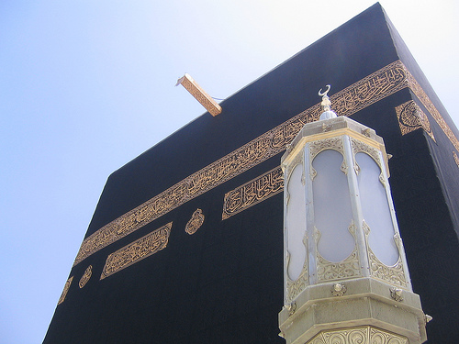
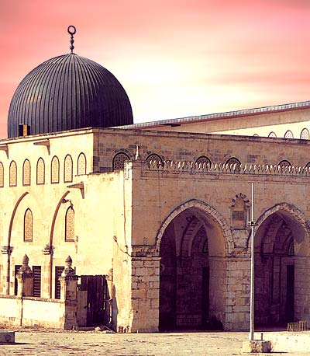
The Prophet’s Night Journey
al-Isra wa’l Mi’raj

Slide 2
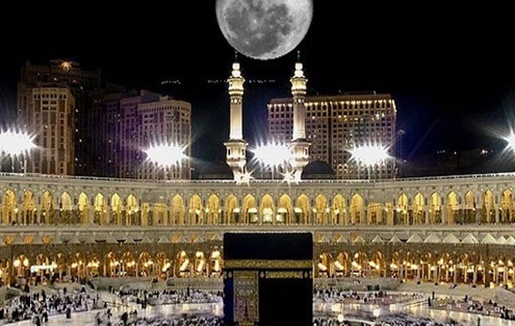
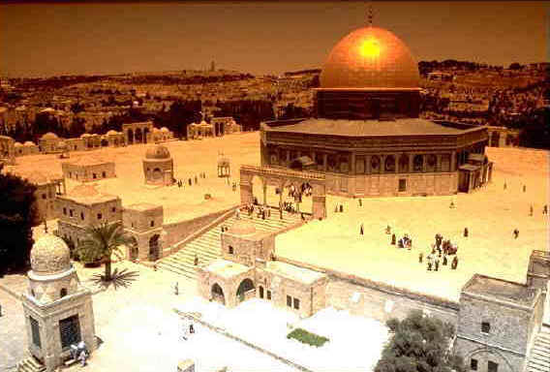
Al-Isra wa’l Mi’raj.
In the month of Rajab, there is a very special night for Muslims called al-Isra wa’l Mi’raj
This is the night when Prophet Muhammad (peace be upon him) was taken on a miraculous journey from Makka to Jerusalem, and then upwards to the heavens.
This night falls on the 27th night of Rajab.

Slide 3
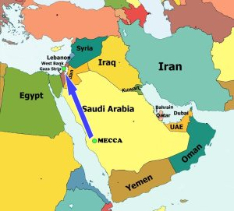
What does Isra mean?
Isra is an Arabic word and it means to ‘travel at night time.’
This word is used to describe the Prophet’s journey from Makka to Jerusalem.

Slide 4
What does Mi’raj mean?
Mi’raj means to ‘go upwards.’
This word is used to describe the second part of the Prophet’s journey, when he went upwards to the seven heavens and then beyond the Throne of Allah.

Slide 5
When the Isra & Mi’raj happen?
When he was living in Makka, Prophet Muhammad had one particularly hard year. This year became known as the ‘year of sorrow.’
His wife Khadija (may Allah be pleased with her) died.
His uncle Abu Talib also died.
He was hurt in Ta’if.
So Allah in return gave Prophet Muhammad the most special night in his life!

Slide 6
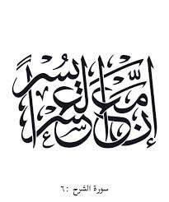
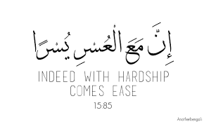
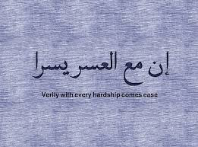
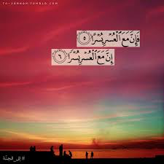
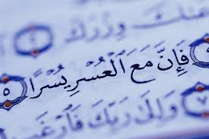
‘With hardship comes ease’
We learn from this that Allah always rewards the Muslims who go through hardship, pain and difficulties.

Slide 7
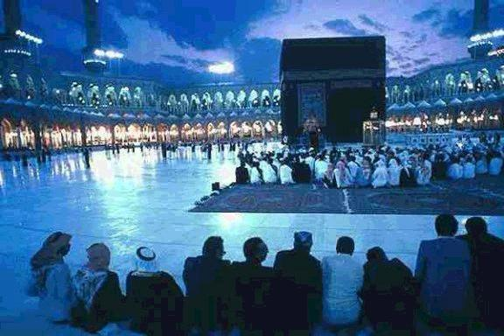
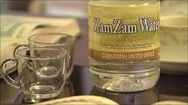
The Isra (Makka to Jerusalem)
1. The Prophet (peace be upon him) was resting next to the Ka’bah when the angel Jibril came.
2. In order to prepare him for the journey, Jibril first cut the chest of the Prophet, removed his heart and cleaned it with Zamzam water.
Zamzam water is the cleanest and best water on earth!

Slide 8
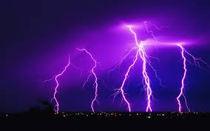
The Buraq.
The Buraq was brought to the Prophet, the animal that was to take him on this journey.
In size, this animal was larger than a donkey but smaller than a mule.
The Buraq could travel extremely fast, faster than lightning.

Slide 9
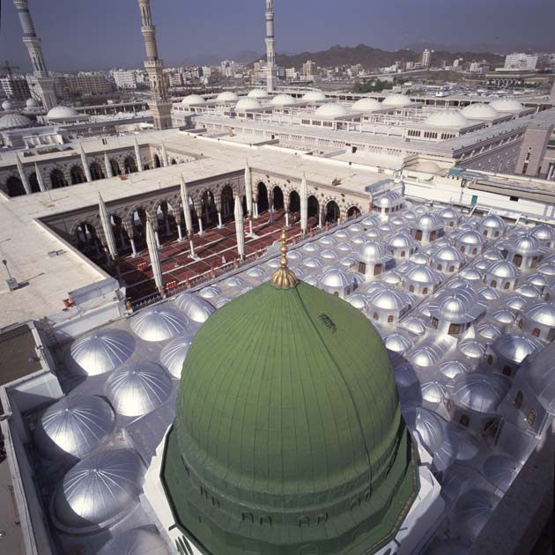
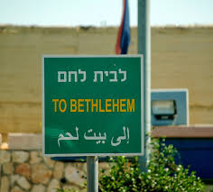
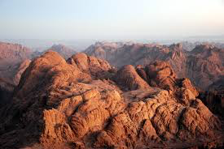
The Journey begins…
Though they were heading for Jerusalem, the journey stopped at important places, where the Prophet prayed Salah. They went to:

Slide 10
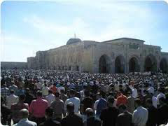
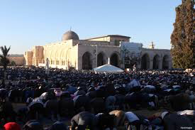
Al-Aqsa Mosque
They eventually reached al-Aqsa Mosque, Jerusalem. There, all the previous prophets & messengers had gathered. The Azan was recited and Prophet Muhammad (peace be upon him) was told to lead the Salah. Everyone else read behind him.

Slide 11
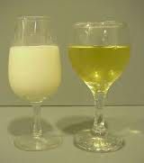
The Milk & Wine.
The Prophet (peace be upon him) left the mosque and was ready for the upward journey (Mi’raj).
Before he did so, Jibril offered him to drink from one of two glasses. One had wine in it and one has milk.
The Prophet chose the milk, upon which Jibril said, ‘You have chosen the (right) natural one.’

Slide 12
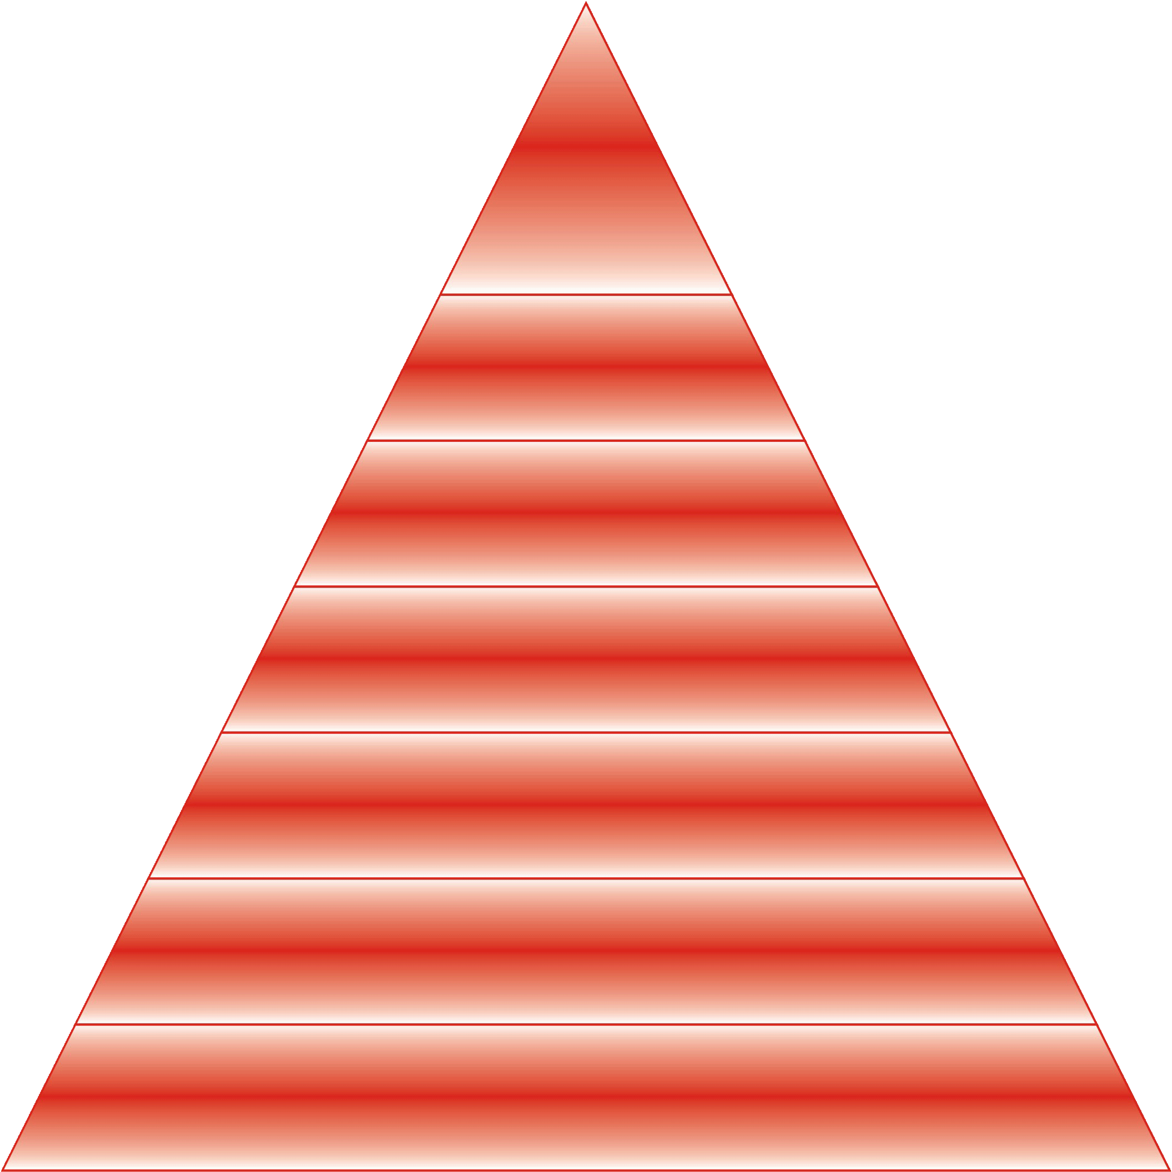
The Mi’raj
SIDRAT AL-MUNTAHA
BAIT AL-MA’MUR
NABI IBRAHIM as
NABI MUSA as
NABI HARUN as
NABI IDRIS as
NABI YUSUF as
NABI ISA as NABI YAHYA as
NABI ADAM as

Slide 13
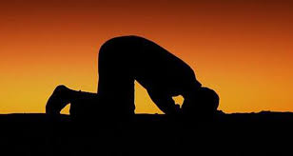
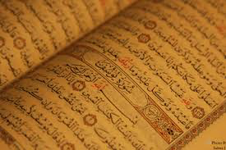
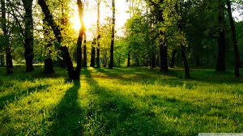
What did the Prophet (peace be upon him) receive?

Slide 14
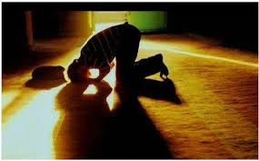
Things that our Prophet (peace be upon him) saw…
When the Prophet (peace be upon him) passed by Musa, he saw him performing Salah in his grave.

Slide 15
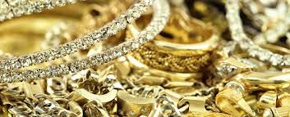
Things that our Prophet (peace be upon him) saw…
When the Prophet (peace be upon him) was visiting the heavens, he saw an old, ugly woman who was decorated with lots of gold and silver. She called out the Prophet’s name but he did not listen and reply. Later, the Prophet asked who the woman was. Jibril replied that she represented the Dunya (world).

Slide 16
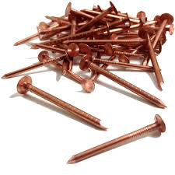
Things that our Prophet (peace be upon him) saw…
Prophet Muhammad (peace be upon him) saw people who had sharp copper nails and they were scratching their faces and chests. He was told they used to do backbiting.

Slide 17
Things that our Prophet (peace be upon him) saw…
Prophet Muhammad (peace be upon him) saw a rock with a small opening from which a big bull came out. That bull tried to go back in the opening but could not. He was told this is the example of the bad word--once spoken, it cannot be returned.

Slide 18
The next day…
When the Prophet (peace be upon him) returned to Makka, he told everyone about his miraculous journey the next day.
Most of the non-Muslims mocked him and did not believe him at all. They could not believe that it was possible to go to Jerusalem and back in one night. This also proves the journey was a real one and not simply a dream. Otherwise, they would not have mocked the Prophet if it was just simply a dream.
Some Makkans had recently returned from Jerusalem and knew what al-Aqsa mosque looked like. The Makkans challenged Muhammad to describe the mosque. He did so perfectly and the ones who had been there confirmed he was right.

Slide 19
The next day…
The Muslims on the other hand believed in Prophet Muhammad (peace be upon him). After all, he had never lied before, why would he lie now?
Abu Bakr (may Allah be pleased with him) accepted the story without hesitation. As a result, Muhammad gave him the title of al-Siddiq (the one who accepts the truth).

Slide 20
Task.
Imagine you were in Makka the day Prophet Muhammad (peace be upon him) told you about his night journey.
Write a journal on what you heard from him. What did he describe? Where did he go? What do you think this says about Prophet Muhammad (peace be upon him? How did his miraculous journey make you feel? Did it make you feel proud?

